Slide 1
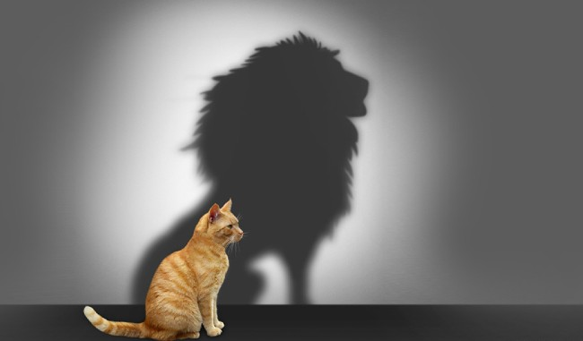

SELF-CONFIDENCE
Presented By
Suresh Mani Thiravia Raj S

Slide 2

Agenda..
What Is Self-confidence?
Types Of Self-confidence
A Brief Self Test
Steps To Overcome Low Self-confidence
  Self Acceptance
  Self Belief. Self Image
  Self Esteem. Self Talk
  Self Analysis

Slide 3
What is Self-Confidence?
Confidence comes from a Latin word 'fidere' which means "to trust"; therefore, having self-confidence is having trust in oneself.
Self-confidence is an attitude about your skills and abilities. It means you accept and trust yourself and have a sense of control in your life. You know your strengths and weakness well and have a positive view of yourself. You set realistic expectations and goals, communicate assertively and can handle criticism.

Slide 4
Types of self-confidence
Low Self-Confidence
Optimal Self-Confidence
Over Self-Confidence

Slide 5
Low Self-Confidence
Staying in your comfort zone, fearing failures and so avoid taking risks.
Governing your behavior based on what other people think
Working hard to cover up mistakes and hoping that you can fix the problem before anyone notices.
Optimal Self-Confidence
Make decision with absolute confidence
Self Confident people inspire confidence in others
Over Self-Confidence
Too much of anything is good for nothing
It is important to be confident but… overconfidence make you egoistic and irritating
Generally, these people have the so called “superiority complex”
Bragging about your qualities and achievements will not make you reach anywhere

Slide 6
A brief Self test
Do you fear or fail to make mistakes?
Do you compare yourself with others ?
Do you feel bad , guilty, nervous and angry when you don’t get what you wanted ?
Do you say “I am like that only or if I… ?
Do you see yourself inferior to others ?
If any answer for these question is “Yes”….
Then I say you are in a state of feeling
“Low confidence”!!

Slide 7
Steps to overcome Low Self-Confidence
Self Acceptance
Self Belief. Self Image
Self Esteem. Self Talk
Self Analysis
Self Acceptance
An individual's acceptance of all their own attributes, positive or negative.”
When we're self-accepting, we embrace every part of ourselves, not just the “positive” things!
Self-acceptance is unconditional, you can recognize weaknesses, but still fully accept yourself.
Accept yourself as you are. Understand “experience is what you get when you don’t get what you want.

Slide 8
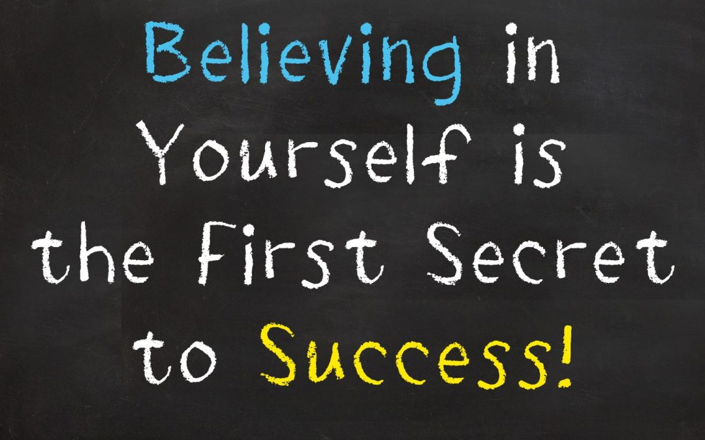
Self Belief
Self-belief (or self-efficacy) is a person's belief in their ability to complete tasks and to achieve their goals
Judging yourself to be capable of success increases your chances of actual success
Remember your childhood :”you never gave-up to stand and walk”

Slide 9
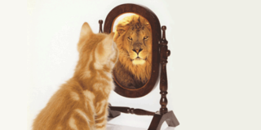
Self Image
Its all how you see yourself.. Matters the most..!!!
Self-image is the personal view, or mental picture, that we have of ourselves. Self-image is an “internal dictionary” that describes the characteristics of the self, including such things as intelligent, beautiful, ugly, talented, selfish, and kind.

Slide 10

Self Esteem
Self-esteem is your overall opinion of yourself in other terms it can also be called self-worth, self-regard, and self-respect.
How you feel about your abilities and limitations?
When you have healthy self-esteem, you feel good about yourself and see yourself as deserving the respect of others.
When you have low self-esteem, you put little value on your opinions and ideas.
Its important that you FEEL good about yourself..!!

Slide 11
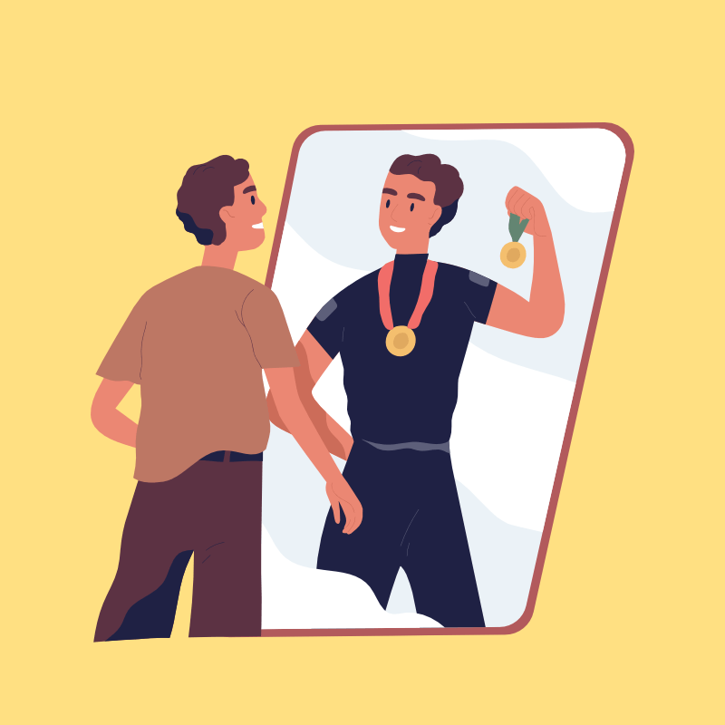
Self Talk
Self-talk is the way you talk to yourself, or your inner voice.
You might not be aware that you're doing it, but you almost certainly are. This inner voice combines conscious thoughts with inbuilt beliefs and biases to create an internal monologue throughout the day.
What you say to yourself matters the most
Examples of positive self-talk are, “I am really happy for myself,” “I am doing well,” or “that is not great, but it could be worse”.

Slide 12

Self Analysis
A systematic attempt by an individual to understand his or her own personality without the aid of another person
Ask on what you have.. and then focus more on where you are lacking behind..!

Slide 13
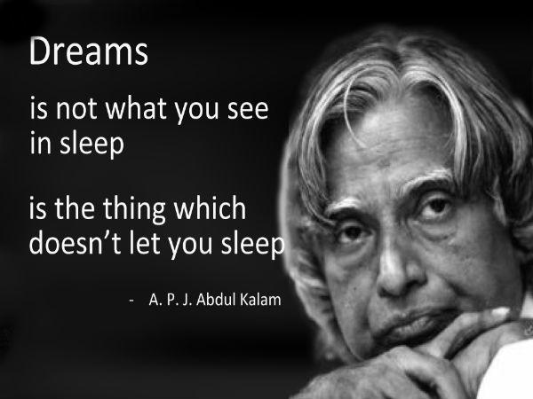
A small boy- the fifth among seven siblings was selling news papers in a small village to earn his living he was not exceptionally smart at school but was fascinated by religion and rockets. The first rocket he built crashed. The missiles he built crashed multiple times. But his “confidence” and get going spirit in him made him script the book “the space odyssey of India single handedly.
He is ….Dr.A.P.J.Abdul Kalam

Slide 14
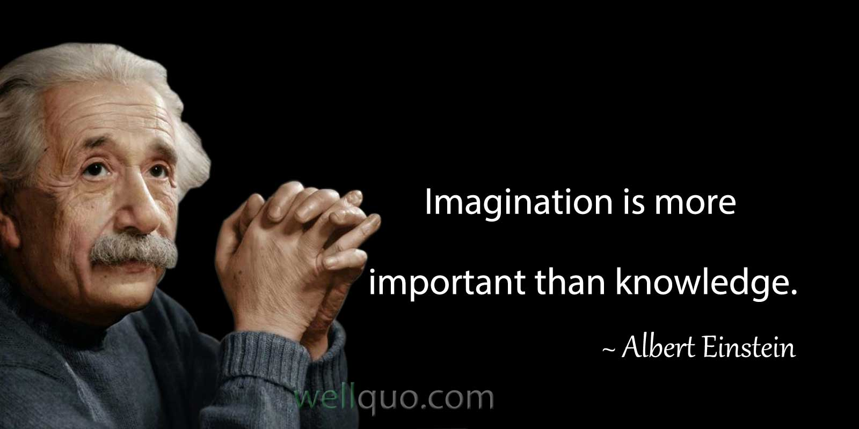
A School teacher scolded a boy for not paying attention in mathematics. For not solving a simple problem. And said that he would not become anybody in life. But his mother’s confidence in him made her coach him mathematics. And the boy went on to become…
He is ….Albert Einstein

Slide 15


Slide 16
The world will say ‘No!’ in a thousand ways.
‘No! you can’t do that’. ‘No! you don’t have the education’.
‘No! you are wrong’. ‘No! you don’t have the background’.
‘No! you are too old’. ‘No! you don’t have the money’.
‘No! you are too young’. ‘No! it can’t be done’.
‘No! you are too weak’.
‘No! it will never work’.
And each ‘No!’ you hear has the
potential to erode your confidence bit by bit until you
quit all together

Slide 17
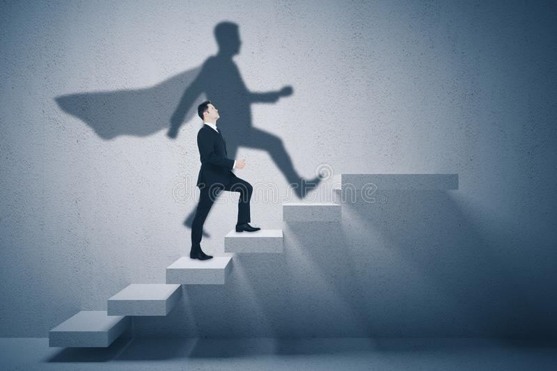
Though the world says, ‘No!’ to you
today, you should be
determined to say ‘Yes!’ and
prove it!”
Confidence does not
come when you have
all the answers…!
But it comes, when
you are ready to face
all the questions..!

Slide 18
And at the end I would like to
say…A winner is not the one
who never fails but.. the one
who never quits.!
Thank you!

